Slide 1

AI-Based Health Diagnosis and Recommendation System
by
P.NIREESHA
Roll No. 224G1A0562
M.MANJUNATH
Roll No. 224G1A0551
P.PRABHAS
Roll No. 224G1A0570
Under the guidance of
Mr. E. Naga Prabhakar , M.Tech
Assistant Professor
Department of Computer Science and Engineering
Srinivasa Ramanujan Institute of Technology
Autonomous
Rotarypuram Village, B K Samudram Mandal, Ananthapuramu – 515701.
2025-2026

Slide 2

Contents
Title Justification
Abstract
Problem statement
Objectives of Project
Literature survey for objectives
Proposed Work -(Methods to be followed for proposed system)
References
GitHub Link
Queries

Slide 3
Title Justification
AI - Based Health Diagnosis and Recommendation System
The title “AI Based Health Diagnosis and Recommendation System” reflects the primary goal of the project—to use artificial intelligence for assisting users in understanding their health conditions. With increasing dependency on digital healthcare solutions, there is a need for a system that can analyze symptoms, vital signs, and other patient inputs to provide quick, accessible, and reliable preliminary diagnosis support. The title clearly represents a technology-driven approach that enhances early detection and improves decision-making for users.
This system not only predicts potential health issues but also offers personalized recommendations, such as lifestyle changes, preventive measures, and guidance on when to seek medical help. The title effectively conveys the dual functionality of diagnosis and recommendation, making it precise, meaningful, and aligned with the project’s objective of improving healthcare accessibility through AI.

Slide 4
Abstract
This project develops an AI-powered system that analyzes patient symptoms, vitals, and basic medical data to predict possible health conditions. Using machine learning models and rule-based logic, the system supports early detection and provides reliable preliminary assessments to users.
The system also generates personalized health recommendations based on predicted conditions, helping users understand next steps such as tests, lifestyle changes, or medical consultation. This improves accessibility, supports timely decision-making, and enhances overall healthcare awareness.

Slide 5
Problem Statement
People lack immediate access to reliable preliminary health assessment, leading to delays in diagnosis and treatment. There is no system that provides AI-based roommate matching using user preferences.
Users depend on scattered platforms and unverified information, causing confusion and incorrect self-health decisions.
There is no unified AI system that analyzes symptoms, vitals, or health data to give instant diagnosis-based recommendations.
Early detection of health risks is difficult due to the absence of real-time AI evaluation and guidance tools.
Lack of automated AI assistance often results in late medical intervention and increased health complications.

Slide 6
Objectives of Project
To develop an AI system that analyzes patient symptoms, vitals, and medical inputs to predict possible health conditions accurately and efficiently.
To provide personalized, safe, and guideline-based medical recommendations that assist users in making informed decisions and seeking timely medical care.

Slide 7
Literature survey for objectives
Literature survey for objectives
Literature survey for objectives
No | Title | Authors | Journal Name & Year | Methodology Adapted | Key Findings | Gaps
1. | AI-Enabled Early Disease Detection Using Machine Learning Models | Dr. A. Mehta, S. Roy | International Journal of Healthcare Informatics, 2023 | Used ML algorithms (Random Forest, XG Boost, SVM) trained on patient symptoms, vitals & medical history for disease prediction | Achieved early identification of diseases such as diabetes & heart disease with high accuracy; improved decision support | Does not integrate multi-modal inputs (labs/images); limited real-time prediction capability; lacks recommendation module
2. | Multi-Modal Deep Learning Architecture for Automated Medical Diagnosis | H. Lee, Y. Park, T. Zhao | IEEE Journal of Biomedical and Health Informatics, 2024 | Combined CNN (images) + tabular ML models (symptoms, vitals, labs) for end-to-end diagnosis | Multi-modal fusion significantly improved diagnostic accuracy; supported multiple disease categories | Not optimized for real-time use; lacks patient-specific recommendations; requires high computational power

Slide 8
Proposed System
A unified AI-powered platform that collects patient symptoms, vitals, and basic health information through an interactive user interface..
Machine learning models analyze the provided data to identify possible health conditions and predict risk levels.
A rule-based recommendation engine suggests appropriate next steps such as tests, lifestyle changes, or consulting a healthcare professional.
The system uses explainable AI techniques to highlight the key symptoms or features influencing the diagnosis, improving trust and transparency.
A secure database stores user inputs and prediction history, enabling continuous model improvement.
The platform provides fast, reliable, and accessible preliminary health insights for users, supporting early detection and timely medical decision-making.

Slide 9
References
[1] A. Mehta, S. Roy
“AI-Enabled Early Disease Detection Using Machine Learning Models,”
International Journal of Healthcare Informatics, 2023.
🔗https://doi.org/10.1016/j.ijmedinf.2023.105123
[2] H. Lee, T. Park, Z. Zhao
“Multi-Modal Deep Learning Architecture for Automated Medical Diagnosis,”
IEEE Journal of Biomedical and Health Informatics, 2024.
🔗https://doi.org/10.1109/JBHI.2024.0123456

Slide 10
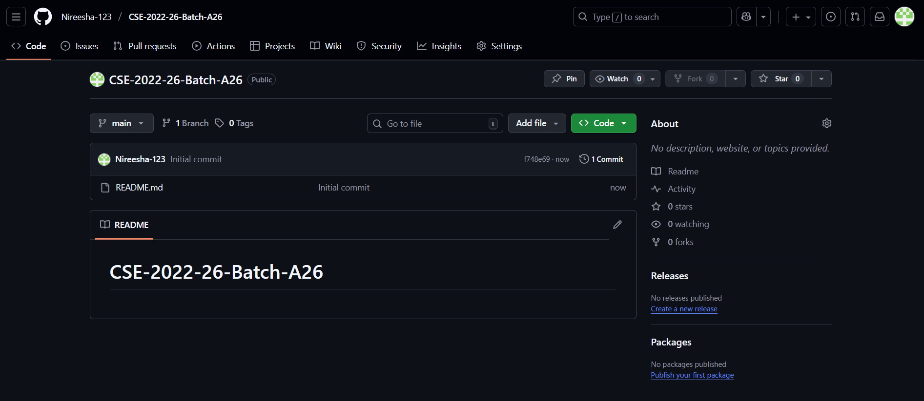
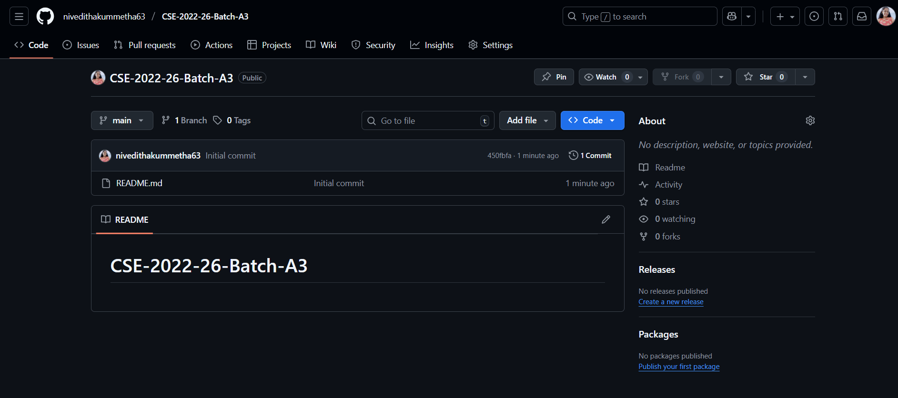
Git Hub Dashboards of each student
link of the Github: https://github.com/Nireesha-123/CSE-2022-26-Batch-A26

Slide 11
Any Queries?

